Slide 1
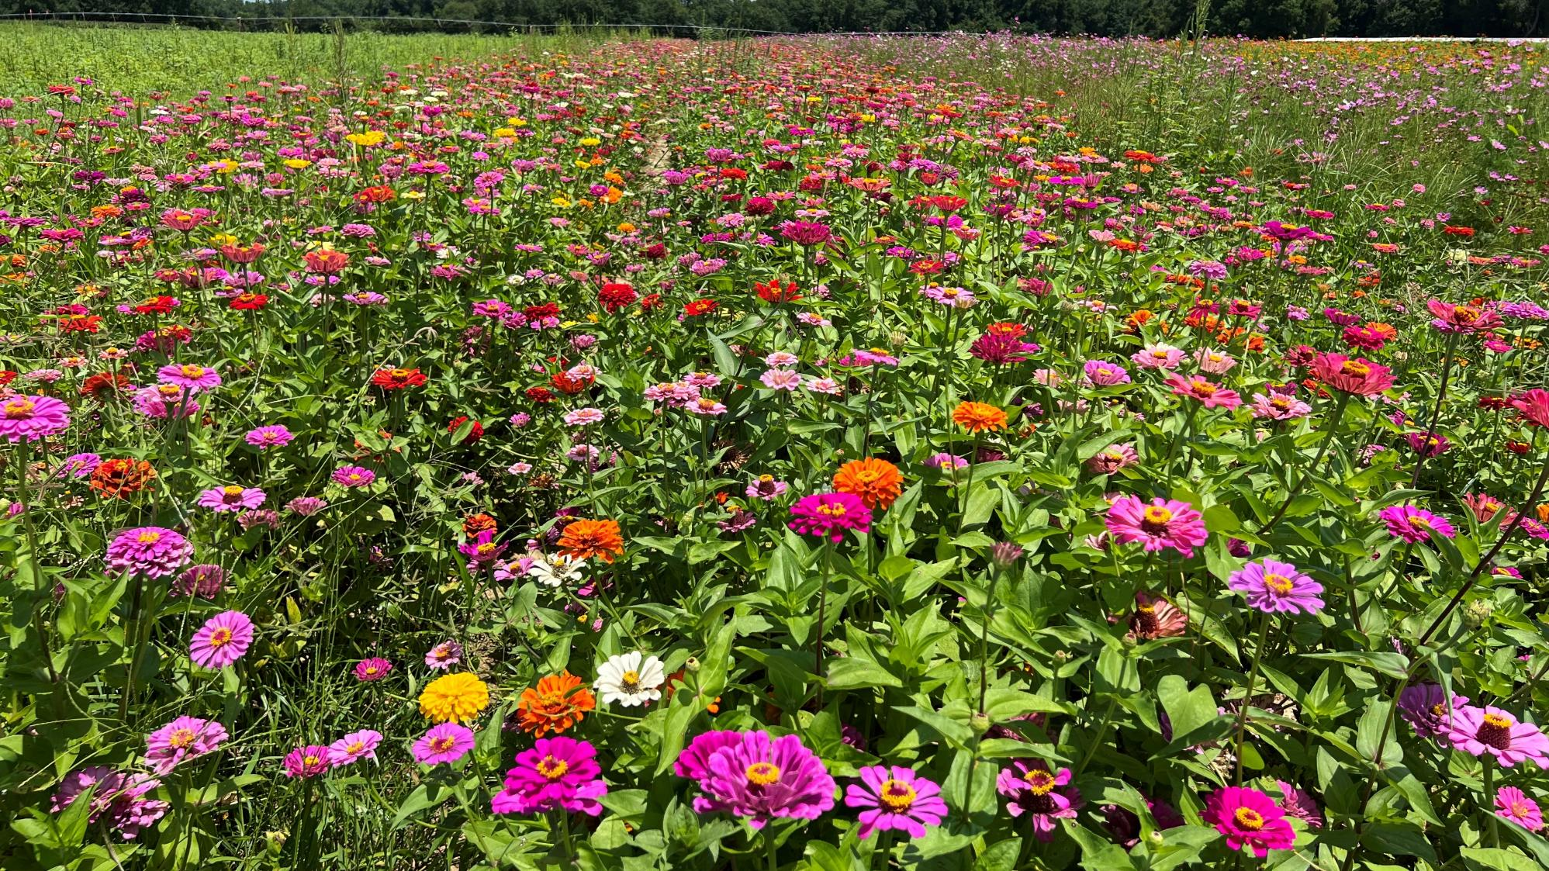
Pollinator/Wildlife/Native Habitat
Taylor Randell Singleton
Extension Sustainability Specialist

Slide 2
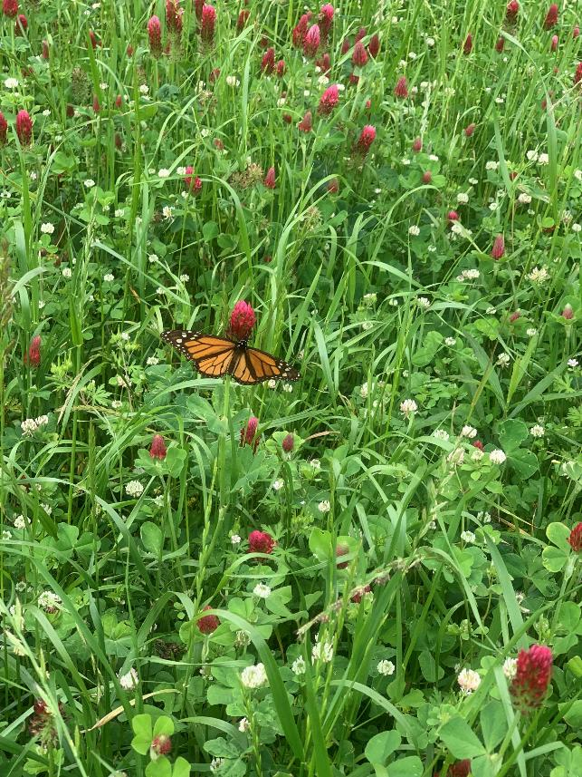
Increased Interest
Support pollinators
Vegetables/agronomic
Pecans/citrus
Cover crops
Unused land – dry corner, field borders, unproductive area
Meadows
Agrotourism – U-pick/photography
Dry corners
Wildlife “habitat”

Slide 3
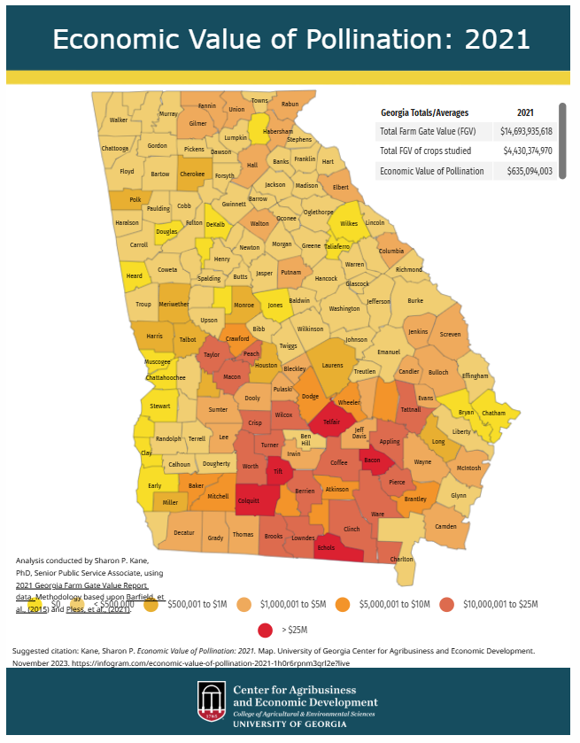
Pollinator Habitat on the Farm
Impact on day-to-day life:
30% of world’s food is pollinated
130+ fruits and vegetable plants
1 in 3 bites of food
Why should you care???
$18-27 billion/yr in US crop yields
GA = $635 million
Services from pollinators is FREE!
Indirect cash crop???

Slide 4
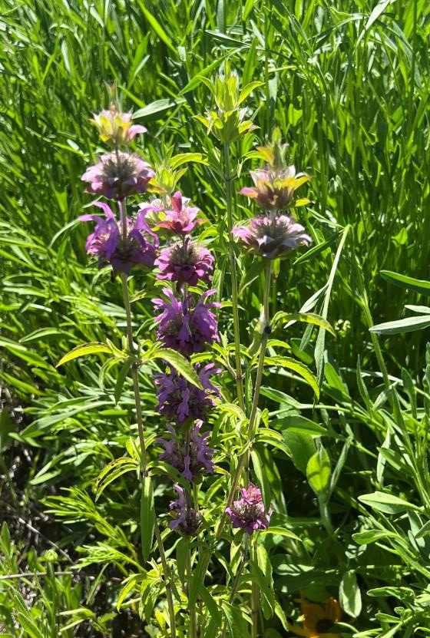
Beyond “Pollination”
No Pollination….no seed….no fruit….no profit…..
Why else should we consider?
Environmental/ecological stewardship
Implications for pesticide stewardship
Public engagement/recreational
Notes:
Without pollination there is no seed….no fruit…..no profit

Slide 5
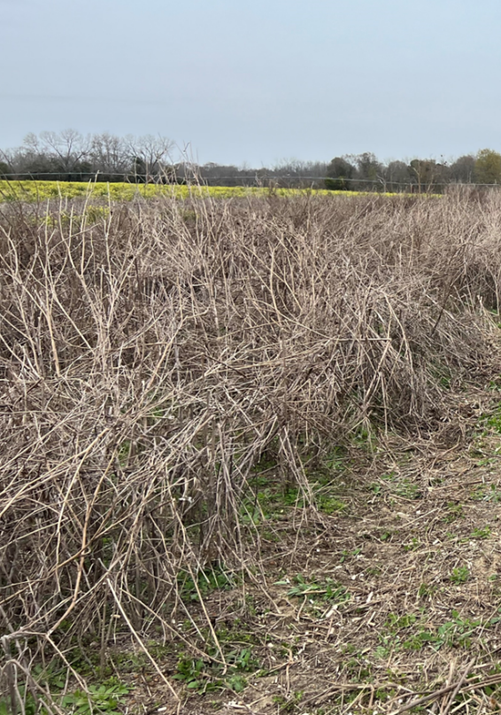
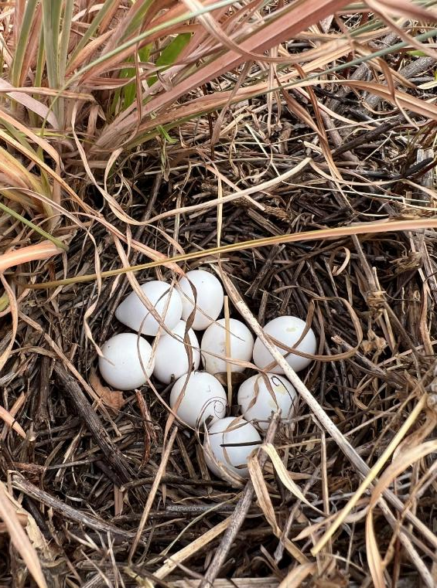
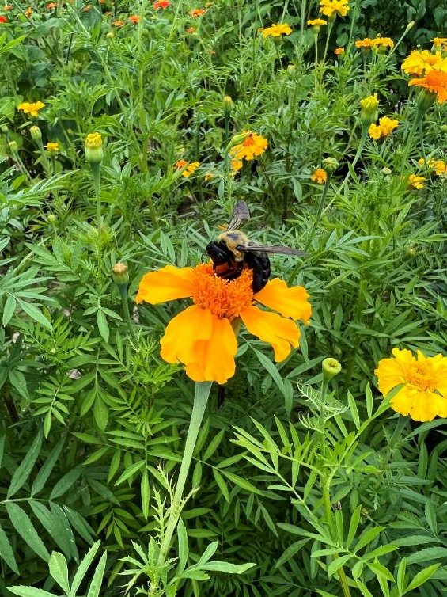
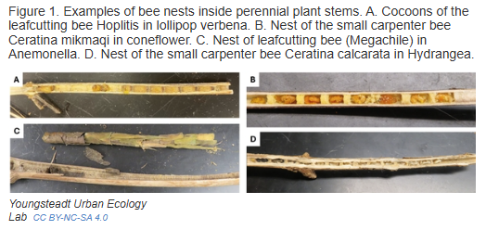
Environmental
Environmental/ecological stewardship
Biodiversity → diverse diet
Wildlife habitat
Help control pests → predators/parasitoids
Notes:
Without pollination there is no seed….no fruit…..no profit

Slide 6
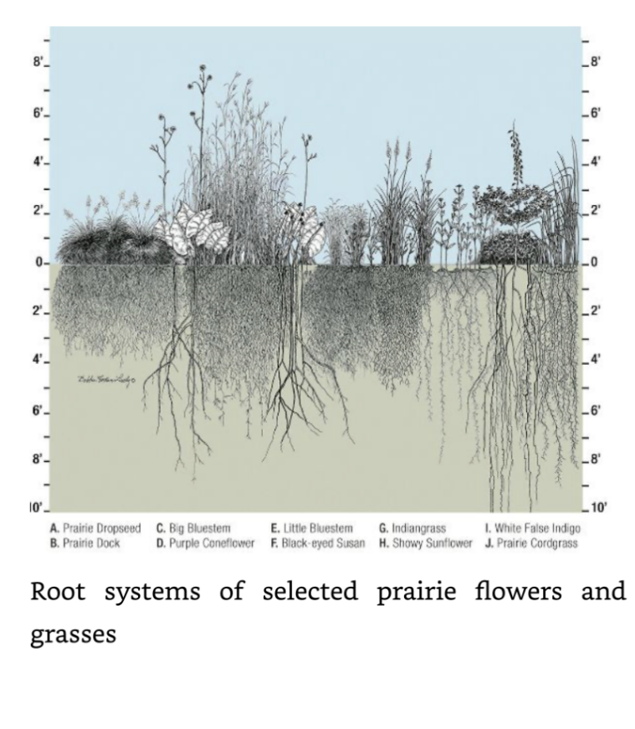
Environmental
Environmental quality
Filter pollutants (runoff/erosion)
Improves air quality
“Heat island” effect in urban areas
Increase soil OM/water infiltration
Sequester carbon

Slide 7
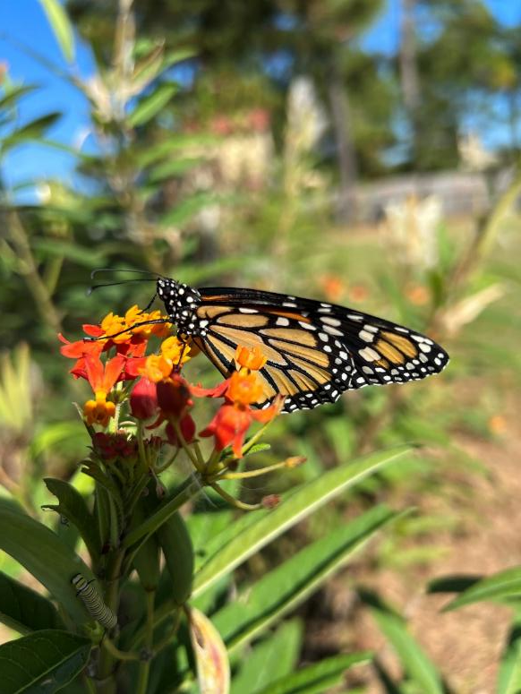
Pesticide Stewardship
Indirect ROI…..hard to quantify
Don’t directly increase yield, etc.
Extra expense to install/maintain
Direct Implications
Supporting endangered/listed/sensitive species
Mitigation for runoff/erosion

Slide 8
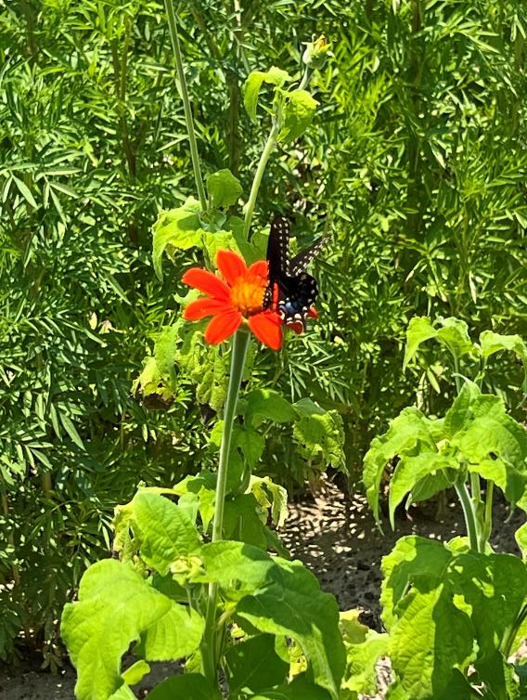
Public Engagement/Recreational
Positive public engagement
Eye catching
Conversations about what’s happening on the farm
Get people onto the farm!
Wildlife/hunting habitat
Economic benefits
Enjoyment
Connection to nature
Notes:
Without pollination there is no seed….no fruit…..no profit

Slide 9
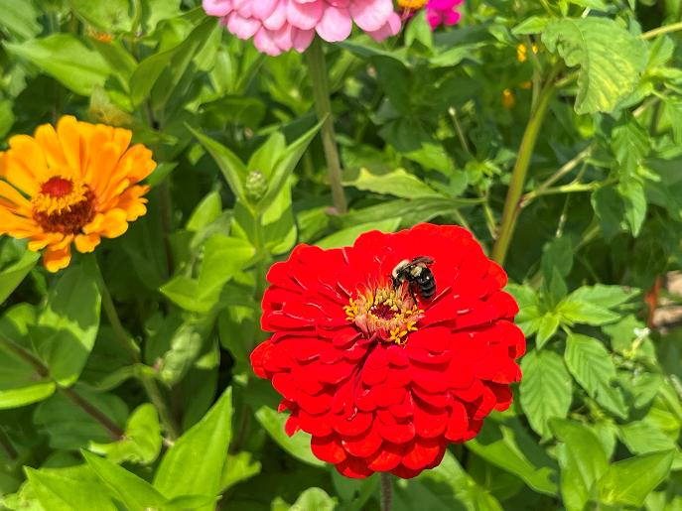
Define Goal of the Site
What does the grower want to accomplish?
This will inform:
What to plant
When to plant
How to manage the site for longevity
What financial resources are available
And most importantly…..what to EXPECT!

Slide 10
Think Through….
Logistics
Equipment
Site conditions (sun/shade/wet/dry)
WEED PRESSURE
Management potential
(Burning? Mowing?)
Site history
Timeline
Land/space commitment
Timeframe to establishment
Ground coverage constraints

Slide 11
Types of Plantings/Sites
Wildlife/hunting habitat
Quail, others
Meadow
Grasses, habitat/grazing (?)
Pollinator habitat
Pollinating insects, flowers
Hybrid
Cover crops, pollinator, agrotourism, etc.

Slide 12
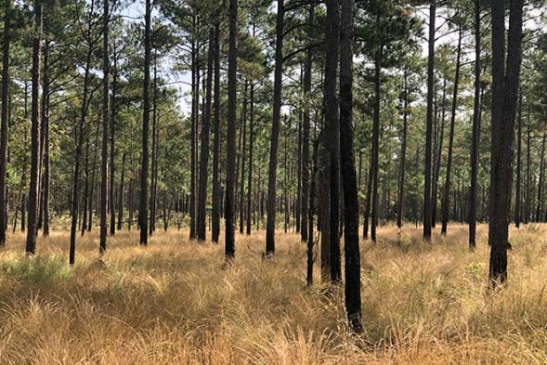
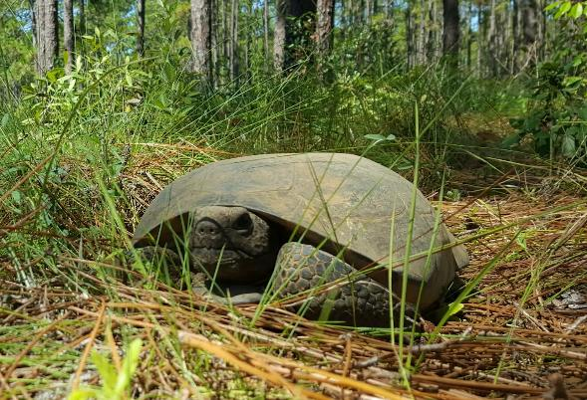
Wildlife Habitat
Many resources available in GA for private landowners:
Georgia DNR
Private Lands Program (PLP)
Wildlife biologists
Quail Forever
Conservation/Farm Bill biologists
NRCS
Resource concern/planning
Georgia Foresty Commission
Land planning

Slide 13
Wildlife Incentive Programs
Including technical assistance and/or financial incentives
**START HERE***
GA DNR Landowner’s Guide to Conservation Resources
https://indd.adobe.com/view/04519a6a-5d2b-44a7-b452-890ef04b8c7d
DNR/Quail Forever Bobwhite Quail Incentive (BQI)
https://georgiawildlife.com/bobwhite-quail
DNR/GFC Forest Stewardship Program (FSP)
https://gatrees.org/forest-management-conservation/forest-stewardship-program/
DNR Open Habitat Incentive (OHI) Program
https://georgiawildlife.com/open-habitat-initiative-rcpp
NRCS – Working Lands for Wildlife (Gopher Tortoise)
https://www.nrcs.usda.gov/programs-initiatives/working-lands-for-wildlife/gopher-tortoise

Slide 14
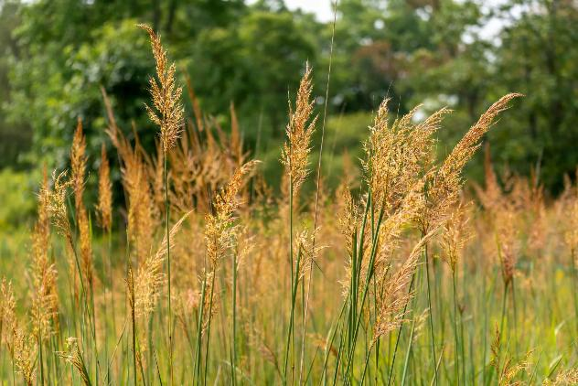
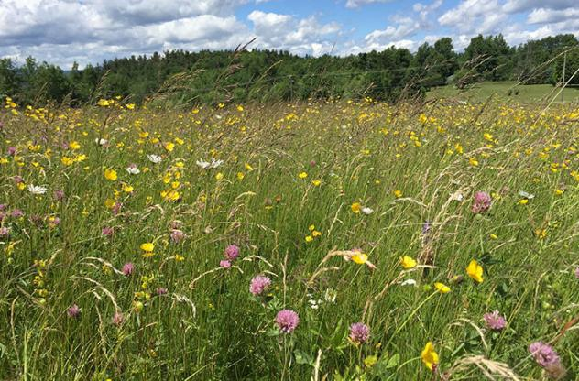
Meadow
Predominately native grasses (typical)
65-70% of total space
LONG TERM COMMITMENT
Often naturally around wooded habitat sites
MUST keep out “invasives”
Can have forbs included
Hard to establish but easy to maintain
Research is growing in this area
NRCS GA PMC
https://fieldreport.caes.uga.edu/publications/B987-4/native-plants-for-georgia-part-iv-grasses-and-sedges-2/

Slide 15
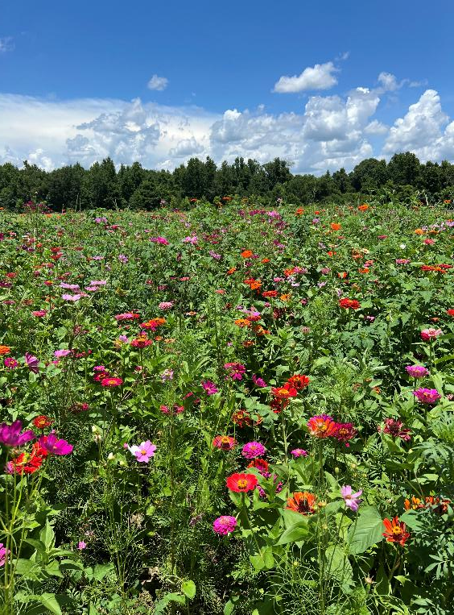
Pollinator Habitat
“Flower-rich” habitat supporting pollinating insects, birds, bats, etc.
Flowering plants, grasses, shrubs, trees
Nectar/pollen throughout growing season (spring/summer/fall)
Water availability
Nesting/foraging materials
Types of species included:
Native
Non-native (commercialized, ornamental)

Slide 16
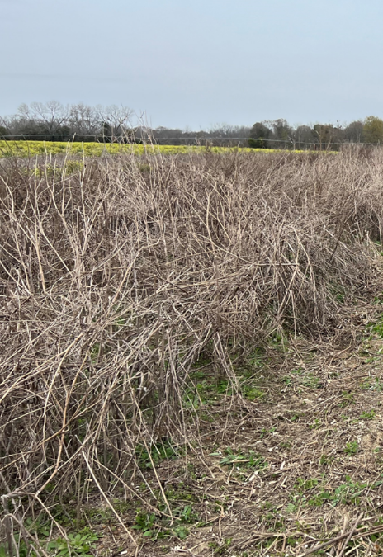
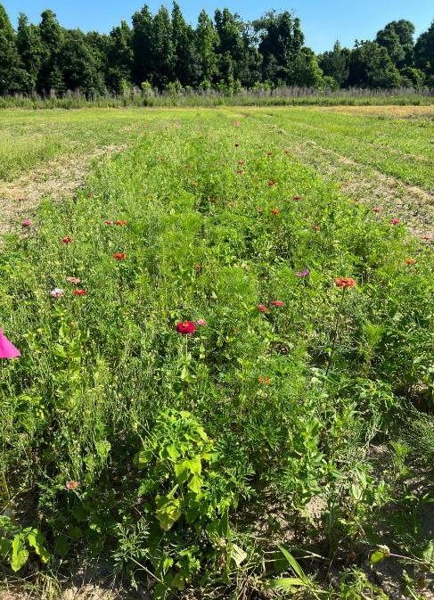
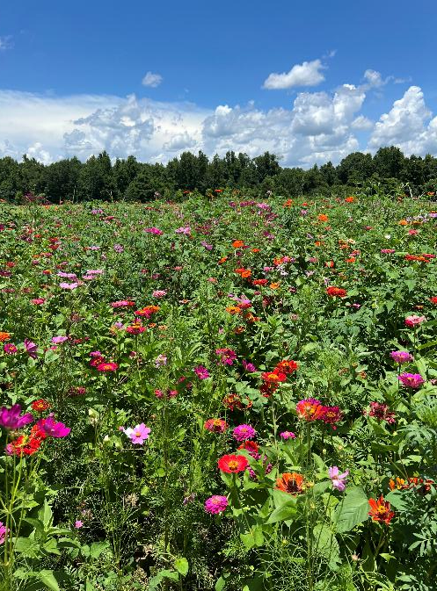
A Year of Pollinator Habitat
Winter ------------------------------Spring -----------------------------------Summer/Fall----------------------------After 1st Freeze/Frost-----

Slide 17
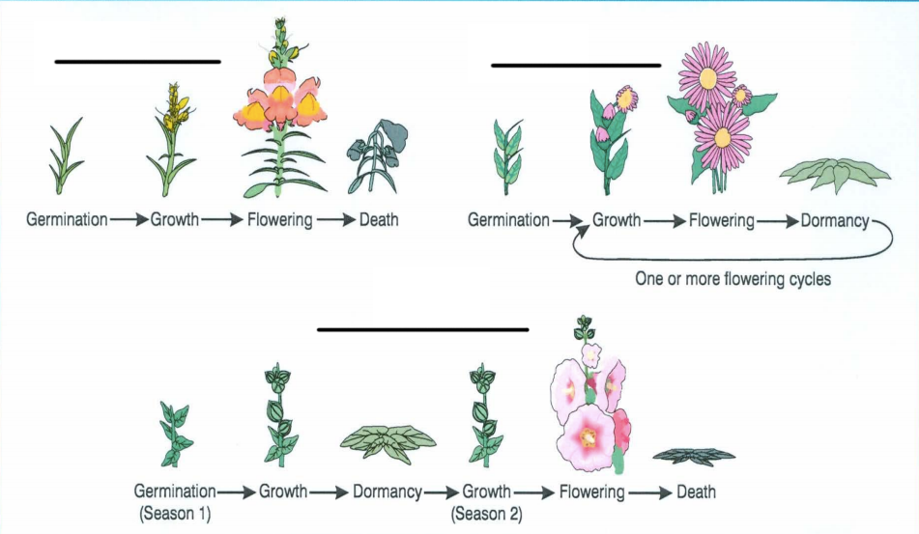
Life Cycle is Important

Slide 18
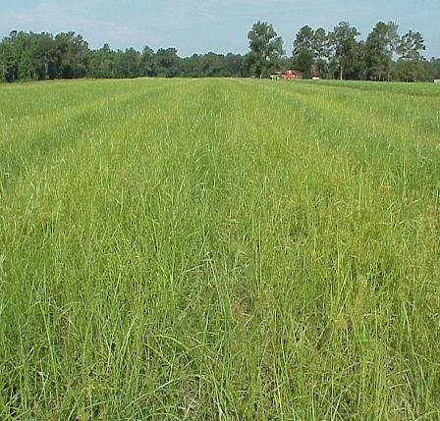
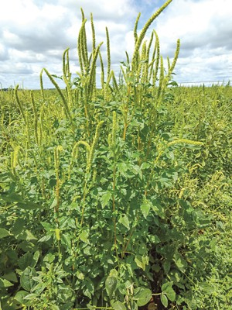
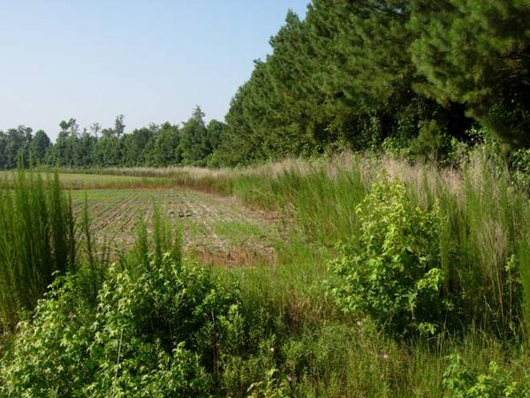
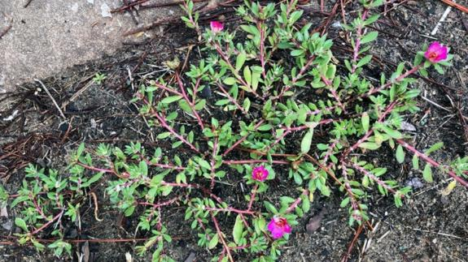
Let’s Plant Habitat on the Farm!
Unproductive, bare area of farm
Can I go throw out some seed?
Not recommended!
Think back to timeline/logistics
$$$$$
Many challenges and questions:
What species?
How to plant?
Maintenance?
WEED CONTROL????

Slide 19
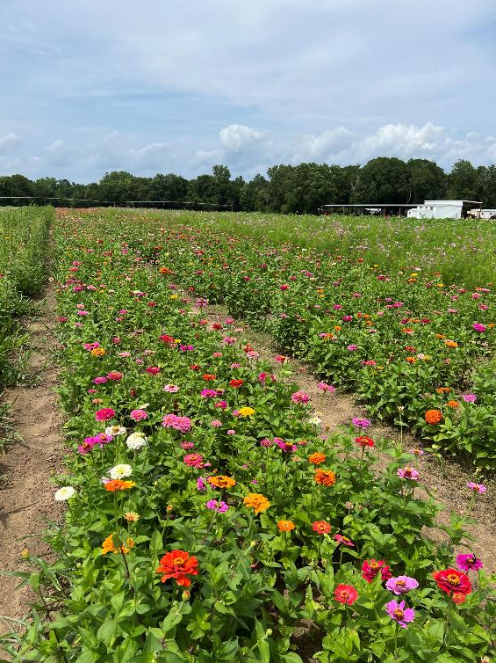
UGA Research Plan
Goal = help you implement pollinators habitat on your farm
Mixture of native species
Weed control during establishment
PRE (residuals)
POST (cleanup)
Persistence over time

Slide 20
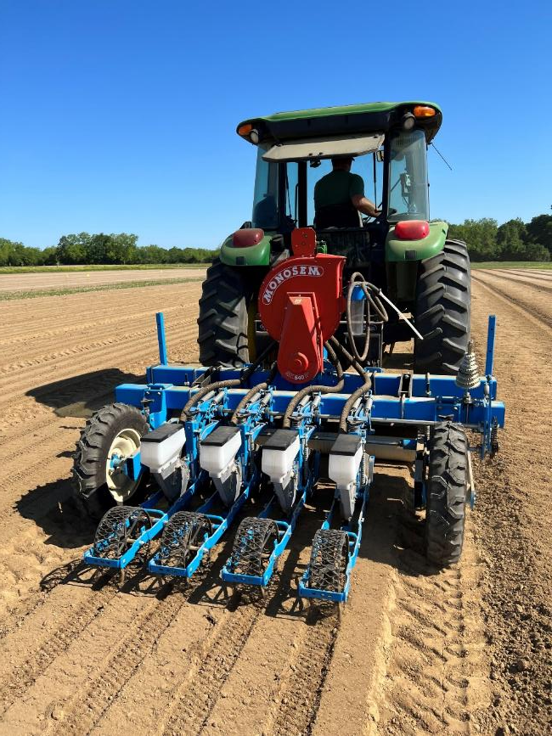
Year 1
UGA Ponder Farm (TyTy, GA)
23 native species
Overhead irrigation
Hand weeded = no competition
PRE/POSTs
NTC for every species
*Perfect planting/growing conditions*

Slide 21
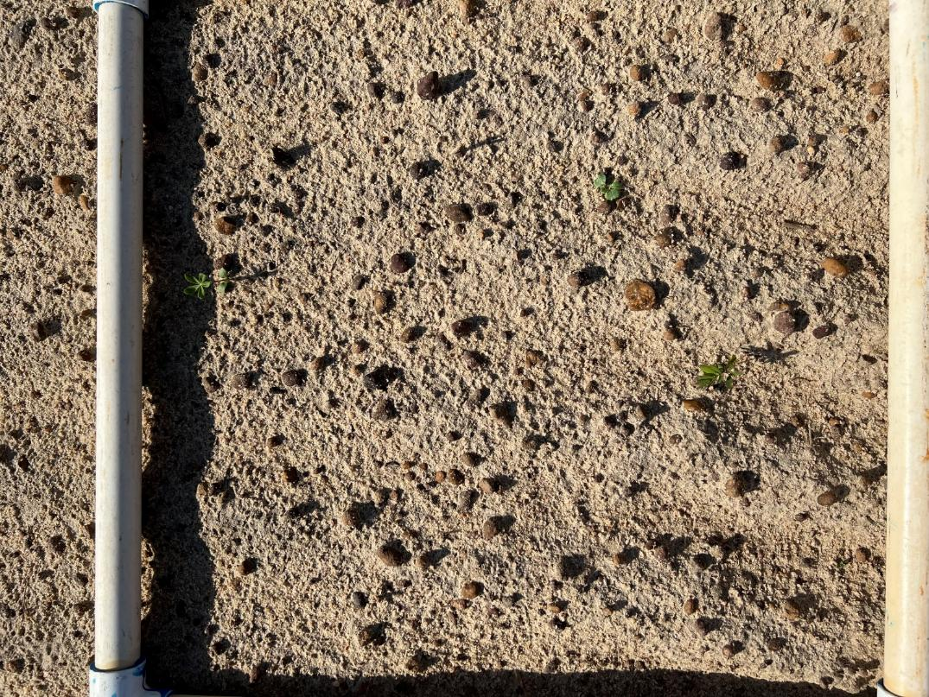
Year 1 = disaster
Seeding rate =
0.5-3.7 lb/a
Emergence
rate = 0-1%
…across 2 sites!

Slide 22
UGA Research Plan
Goal = help you implement pollinators habitat on your farm
Mixture of native species
Weed control during establishment
PRE (residuals)
POST (cleanup)
Persistence

Slide 23
UGA Research Plan
Goal = help you implement pollinators habitat on your farm
Mixture of native species
Weed control during establishment
PRE (residuals)
POST (cleanup)
Persistence

Slide 24
Year 2/3 → Switch Focus
Start with commercialized annuals, add in natives after establishment
Fast growing
Hardy
Herbicide tolerance?
PRE herbicides → screen for tolerance across wide range of products
Zinnia, Cosmo, Marigold, Mexican sunflower

Slide 25
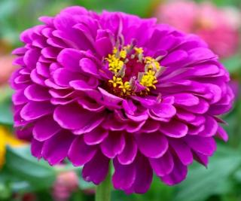
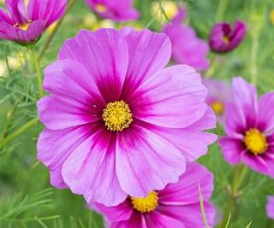
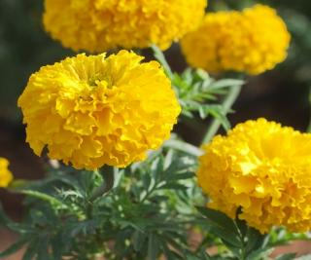
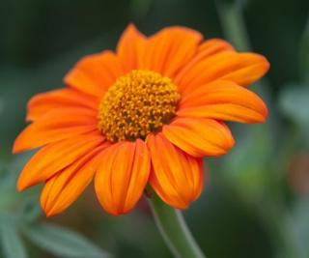
Screening for Everything (PRE)
3 years ….and running!
Alite (Axant)
Axiom
Brake
Cadre
Caparol
Command
Dacthal
Devrinol
Dual Magnum
Enversa
Eptam
Goal
Goltix
Nortron
Prowl
Pursuit
Reflex
Spartan
Staple
Torero
Treflan
Chateau/Valor
Warrant

Slide 26
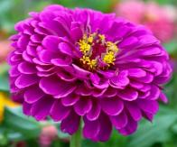
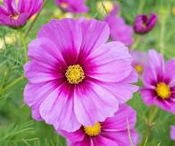

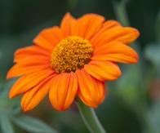
Screening for Everything (PRE)
NO | MAYBE (adjust rate?) | YES
Command | Warrant | Devrinol
Eptam | Axiom | Prowl
Valor | Dual | Treflan
Brake | Nortron
Reflex | Enversa
Cadre
Pursuit
Alite 27
Goal
Caparol
Staple
Spartan
Goltix
Torero
Data Collected
Injury/tolerance
Height
Stand
Time to bloom
Bloom counts

Slide 27
Fundamentals of Weed Science
Principles of SOUND weed management still apply!!!!
Remembering what Drs. Culpepper/Prostko have taught us for years
Systems approach, diversified, timely, smart!
Clean @ planting
PRE residuals
POST if needed…keep it clean
Manage grass
On Going Work
Systems approach
How to plant for optimum ground coverage?

Slide 28
Creating a Systems Approach to Weed Control*
2026:
Expand on tank mixtures/study rates….add new products?
*Fall 2024/Spring 2025 – 1 location; 3 reps

Slide 29
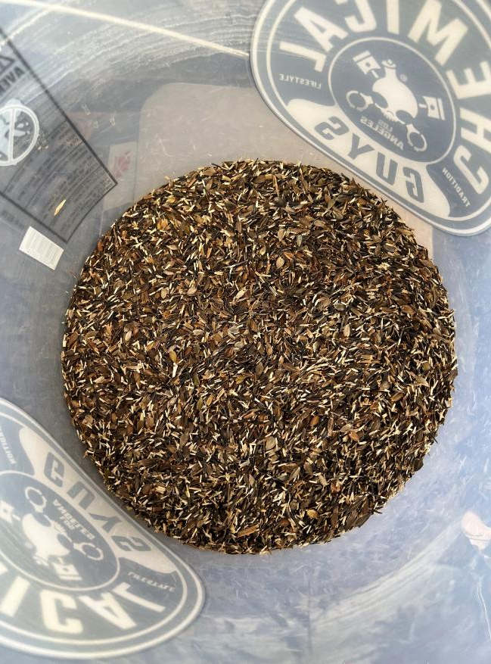
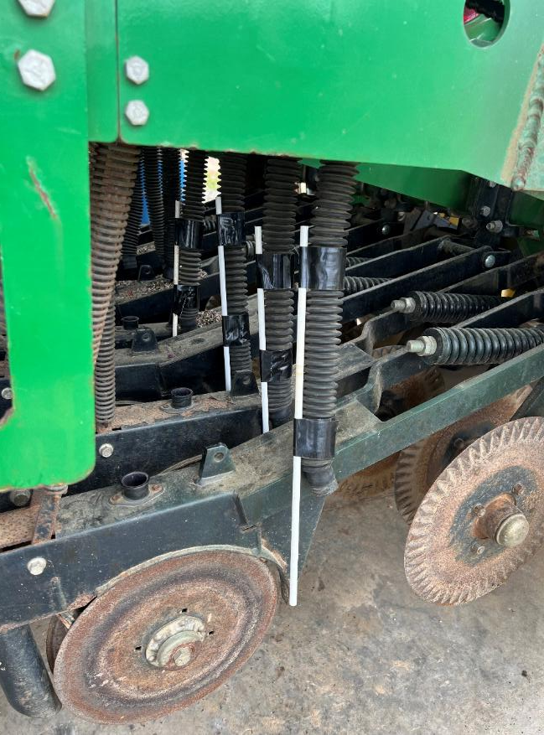
Year 3 – Integrated Approach to Weed Mgmt

Slide 30
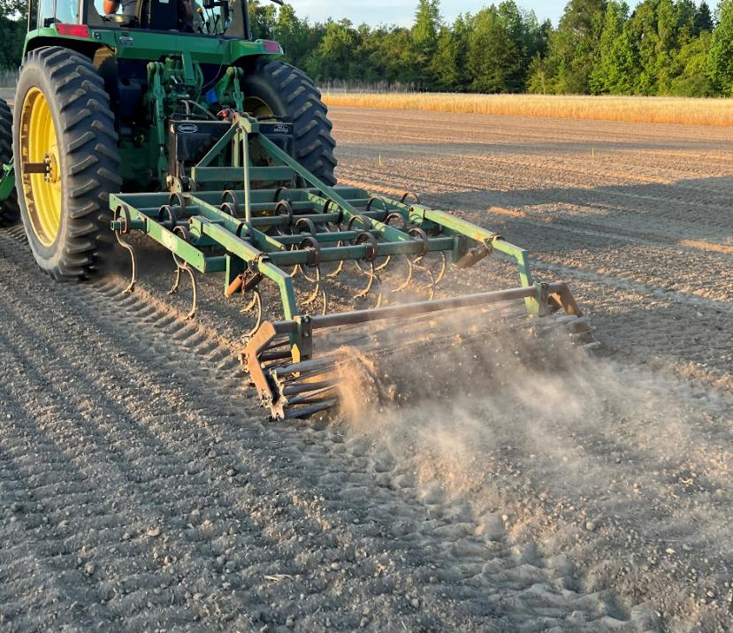
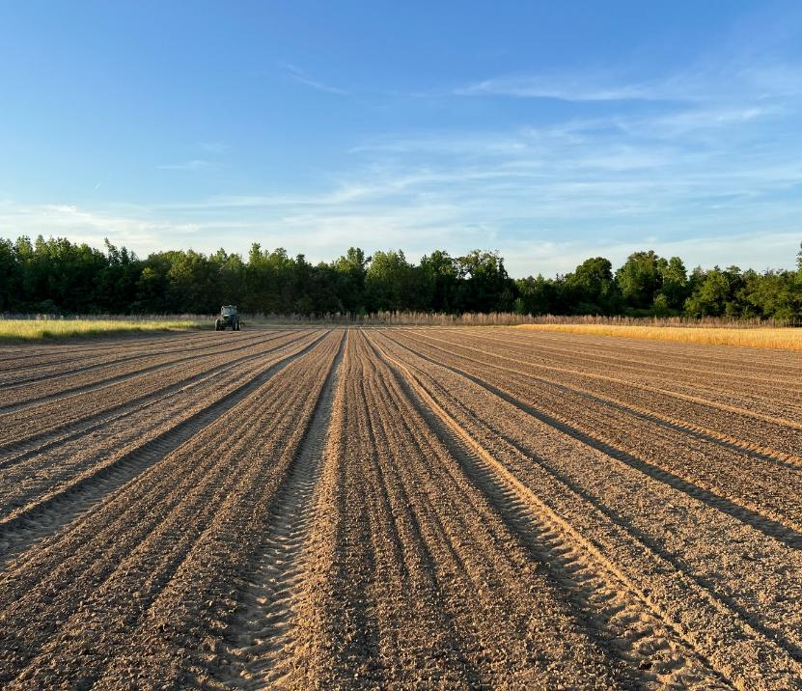
Year 3 – Integrated Approach to Weed Mgmt

Slide 31
Integrated Approach to Weed Mgmt
Ground Coverage (%)
25% faster ground coverage w/drilled
Consider higher ratios of “aggressive growers”
Ratio: Zinnia/Cosmo/Marigold/Mex Sun

Slide 32
Planting Method Influences Bloom
25% faster blooming w/ drilled =
More time for pollinator services

Slide 33

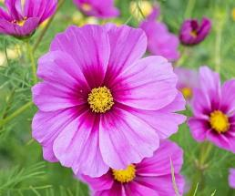
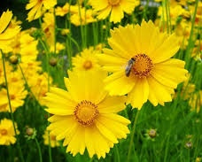
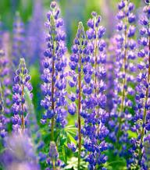
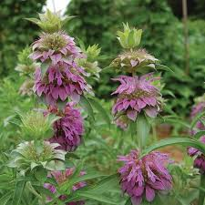
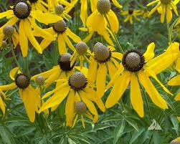
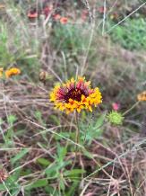


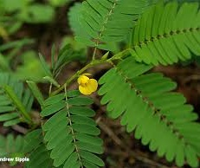
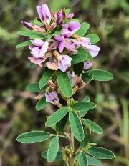
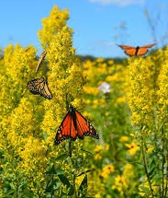
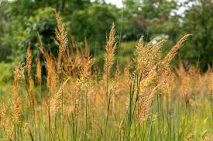
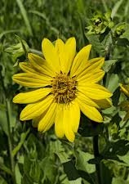
Year 3 – Collaborating with NRCS
UGA + NRCS USDA Jimmy Carter Plant Material Center
Comparing UGA vs NRCS “mixes”
What establishes? Blooms? Weed control?
UGA Mix
NRCS Mix

Slide 34



NRCS Mixture – Site 1
Flwr1-24
51 DAP
No herbicide
PRE: treflan
POST: none
PRE: none
POST: cadre

Slide 35



UGA Mixtures – Site 1
Ratios = Zinnia/Cosmo/Marigold/Mexican sunflower
Flwr1-24
51 DAP
25/25/25/25
40/30/20/10
“low” seeding rate
40/30/20/10
“high” seeding rate

Slide 36



NRCS Mixture – Site 2
Flwr2-24
Ponder Farm
51 DAP
No herbicide
PRE: treflan
POST: none
PRE: none
POST: cadre

Slide 37



UGA Mixtures – Site 2
Ratios = Zinnia/Cosmo/Marigold/Mexican sunflower
Flwr2-24
Ponder Farm
51 DAP
….cover the ground to suppress weed for native establishment next “season”?
Few weeds, great ground coverage…..
25/25/25/25
40/30/20/10
“low” seeding rate
40/30/20/10
“high” seeding rate

Slide 38
My Thoughts - Natives vs Non-Natives
Long-term, these habitats need to be majority natives
Regen. mechanisms are adapted for GA
Less potential for “invasive/weedy” characteristics
But, NOT competitive with weeds and SLOOOOOOW
Non-native, commercial species can buy us time….
Cover the ground, suppress weeds
Lots of blooms and color year 1
Still providing a service to pollinators

Slide 39
Installation Recommendations
Start getting rid of weeds NOW!
Burndown herbicides/tillage to clean site
Once established, NO KNOWN OPTIONS for broadleaf weeds
Select species and mixes:
Program requirements?
Select suitable mix carefully (SE adapted species, wet/dry site)
Supplement with non-native (zinnia, cosmo)
Creating their own?
I like UGA mix with understanding to supplement year 2 & add natives overtime

Slide 40

Installation Recommendations
Be prepared to spot spray if needed
Manage over winter – after first frost/freeze
Consider leaving residue (it will look bad but it’s really good habitat!)
Mow after frost/before green up to spread seed
Burning is also good

Slide 41
Seed Sources
Roundstone Native Seed Company
Mix SS-W1 - Southern Pollinator Conservation Mix - Roundstone Native Seed Company
Mix HB-1 - Honey Bee Specialty Mix - Roundstone Native Seed Company
Mix 124 - Coastal Mixed Grass Meadow Economy Mix - Roundstone Native Seed Company
Mix 122 - Coastal Mixed Grass Meadow Mix - Roundstone Native Seed Company
Mix 118 - Coastal Tall Grass Meadow Mix - Roundstone Native Seed Company
Mix 178 - Southern Annual and Perennial Native Wildflower Garden Mix - Roundstone Native Seed Company – *this is my preferred mix based on the components
Ernst Conservation Seeds
Ernst Southeastern U.S. Roadside Native Mix Seed (this mix includes a native grass)
Southeast Annual and Perennial Wildflower Mix – *this is my preferred mix based on the components
Eden Brothers
Commercialized annuals, non-native, ornamentals

Slide 42


Financial Resources
https://indd.adobe.com/view/04519a6a-5d2b-44a7-b452-890ef04b8c7d

